Slide 1

Exploratory Data Analysis on Aspiring Mind Employment Outcome (AMEO) Dataset
By
Tejeswara Sai Reddy

Slide 2
About me
Hola ! I’m Tej, a 20 year-old Data Analytics fresh graduate from Asia Pacific University, Malaysia. My academic journey has been well versed with numerous assignments using tools like Python, SQL, Power BI and Excel. I enjoyed the process of analysing data and solving problems throughout the coursework and I aim to continue to do so in my career.
Previously, I worked as as Data Analyst and Web Dev Intern at Asian Football Confederation, a subsidiary of FIFA. I have worked there for 4 months learning visualization tools such as Power BI, Tableau, Google Analytics and developed a user registration system with HTML, CSS, JS and PHP.
In my Final Year at University I have developed a House Price Prediction Model with Machine Learning algorithms with an accuracy of 87%.
Have a look at my portfolio below :
Portfolio Website - Linkedin - Github

Slide 3
Description
Objective
The dataset, derived from the Aspiring Mind Employment Outcome 2015 (AMEO) study by Aspiring Minds, focuses solely on engineering students. It encompasses employment results such as salary, job titles, and job locations as dependent variables. Additionally, it includes standardized scores for cognitive skills, technical skills, and personality traits, alongside demographic information. With roughly 40 independent variables and 4000 data points, the dataset comprises a mixture of continuous and categorical variables, each candidate being uniquely identified.
The main objective is to analyse the AMEO dataset with target variable as Salary. A thorough analysis is required to understand the factors that influence and don’t influence the salary column. This can be achieved through Exploratoty Data Analysis (EDA), starting with understanding, cleaning, and transforming the data.

Slide 4
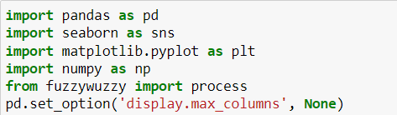
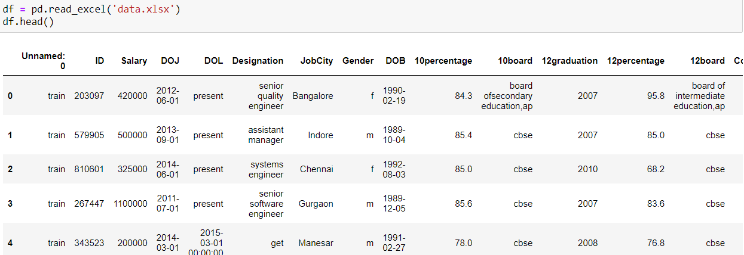

Importing and Cleaning
The first step is to load the necessary libraries required for the analysis
Next, I have loaded the dataset using pandas.
After Loading the Data, the first step is to remove the irrelevant columns from the data set. Upon observation, in this dataset the first column which is unnamed and has values of train is irrelevant and hence is removed.
Moreover there are a few ID columns like 'ID', 'CollegeID' and 'CollegeCityID' these are also dropped using the drop() method in pandas.

Slide 5
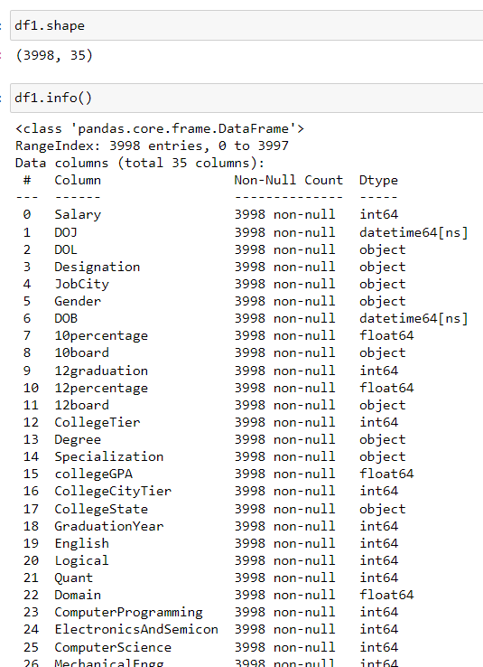
Data Understanding
Followed by dropping unused columns, I understood the data by looking into its shape to identify the number of columns and rows and also the info() method to look into the data types and null values.

Slide 6
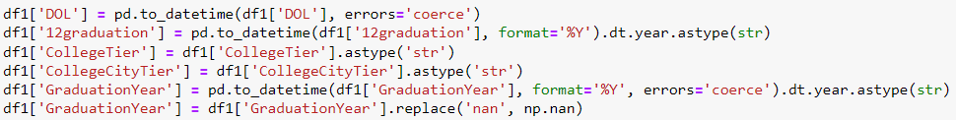
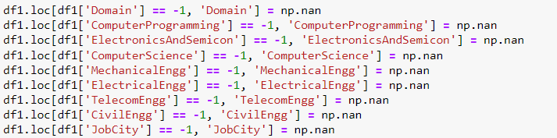
Data Transformation
A few of the datatypes are inconsistent and must be transformed to relevant data types. I have performed that and fixed the issue and verified it with info() method.
Moreover I have also noticed that a few columns are having values as -1. This is an inconsistency with the data type, according to domain knowledge this means that there is no data in its place or the user refused to fill it. For numerical columns especially this -1 value could hinder with our analysis. Hence I replaced it with Null Values.

Slide 7
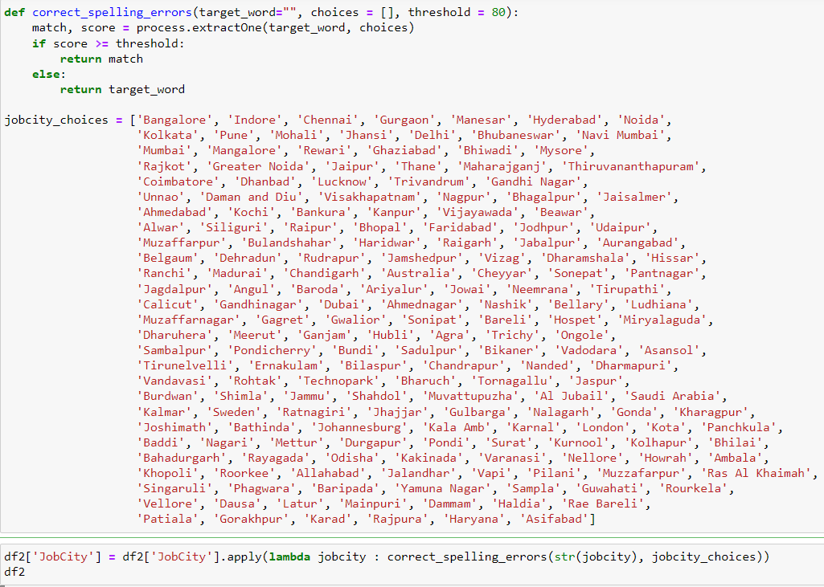
Data Transformation
Next, I moved on to the categorical columns, I have looked into the unique values in JobCity and noticed there are few mispellings and repeated values because of case sensitivity.
I fixed the inconsistencies in JobCity column by using Levenshtein Distance method.

Slide 8
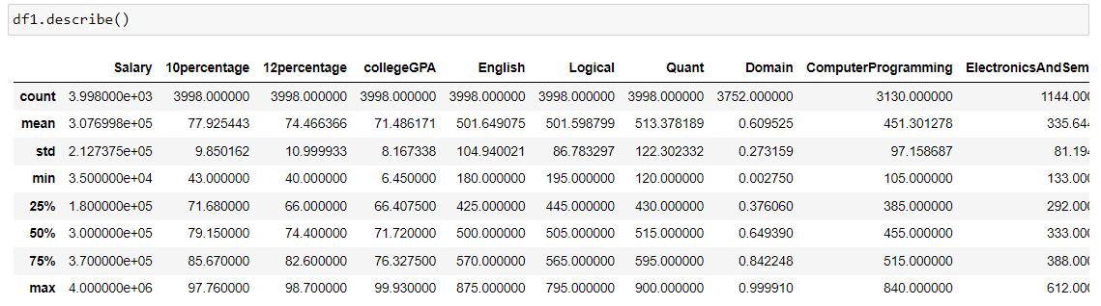
Data Exploration
I have used describe() method to look into the descriptive statistics of the numerical columns in the dataset.

Slide 9
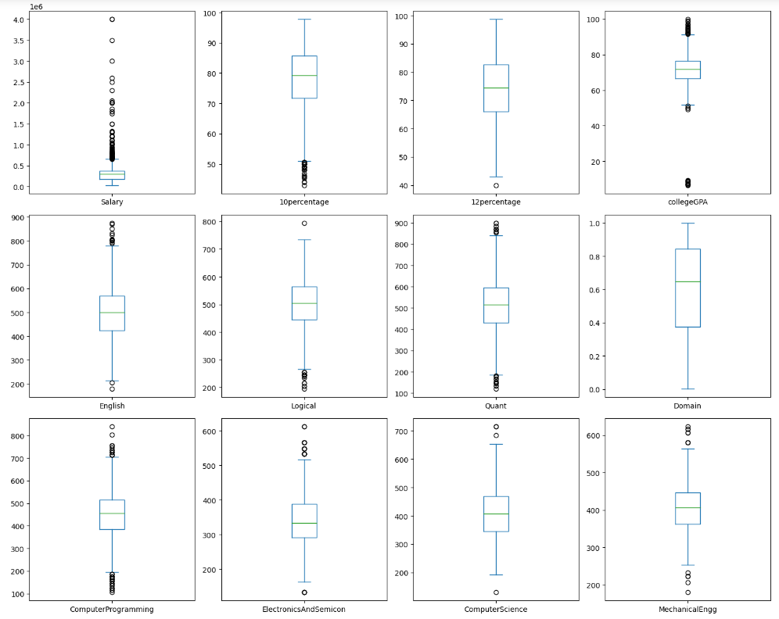
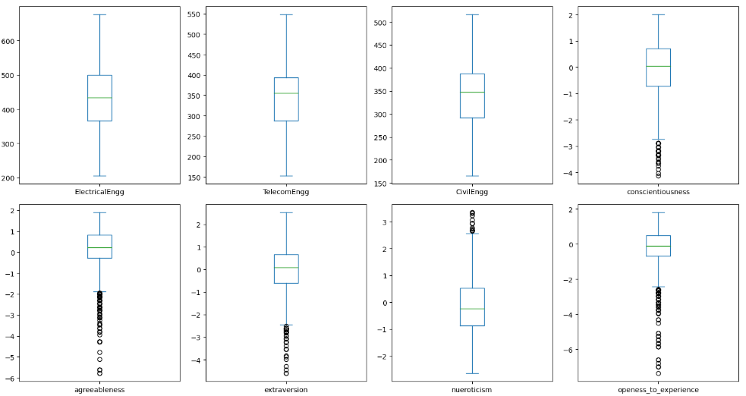
Univariate Analysis
Next, I have divided the columns into numerical columns and plotted box plots of them.

Slide 10
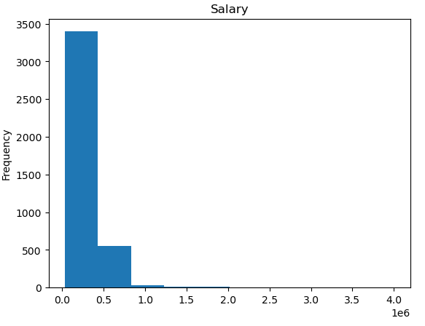
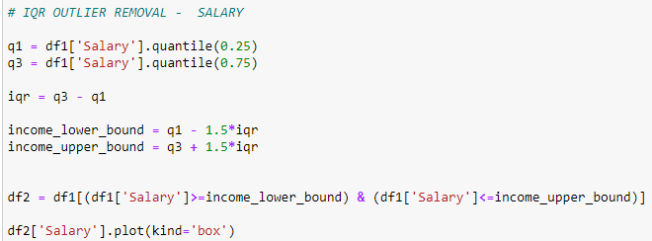
Univariate Analysis
Upon visually analysing the salary column, it is right skewed and needs some fixing to analyse it
I removed the far outliers in salary using IQR method. Now the outliers are much less and are closely bound to the range

Slide 11
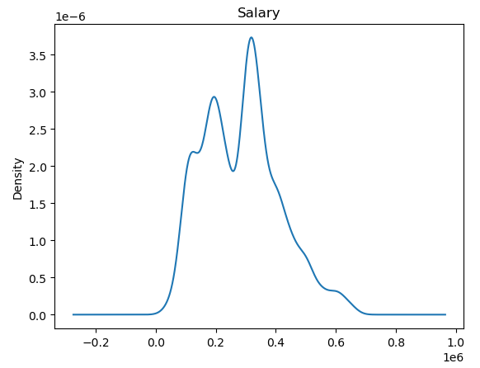
Univariate Analysis
The KDE plot of salary column shows the presence of a bell curve like shape i.e a normal distribution

Slide 12
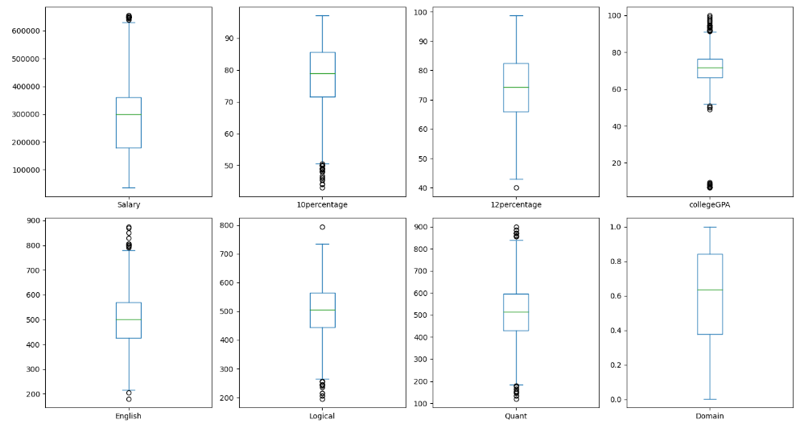
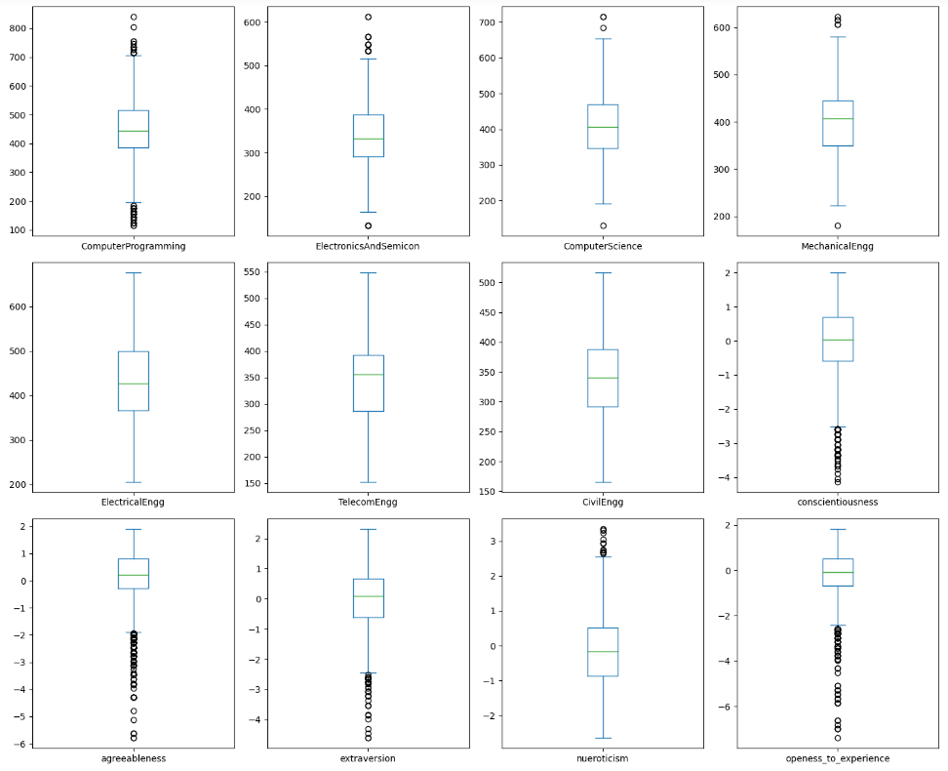
Univariate Analysis
I have plotted the box plots for all variables and this time the outliers are much less and is better to perform analysis

Slide 13
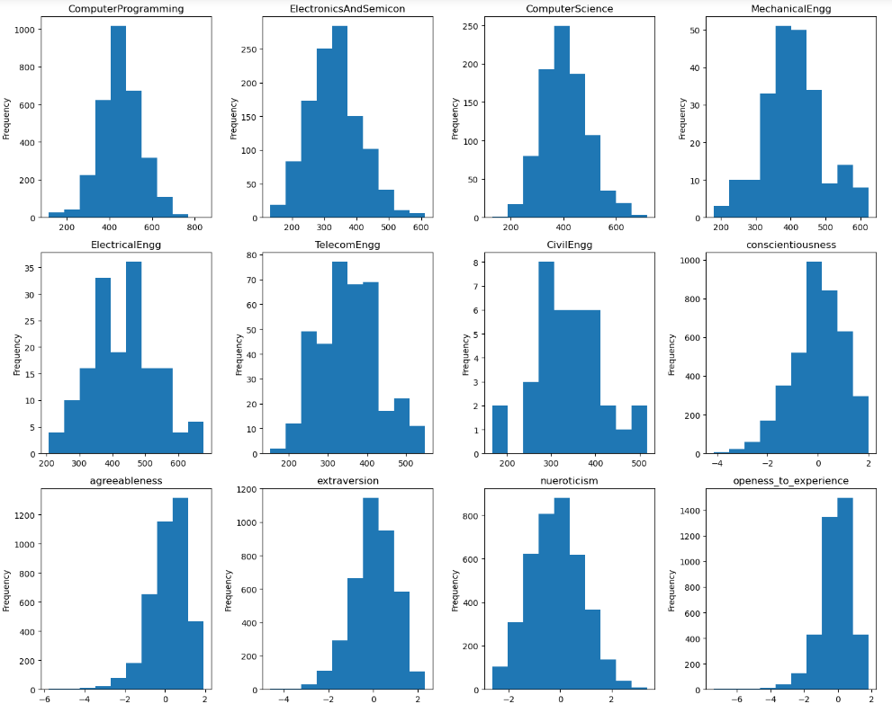
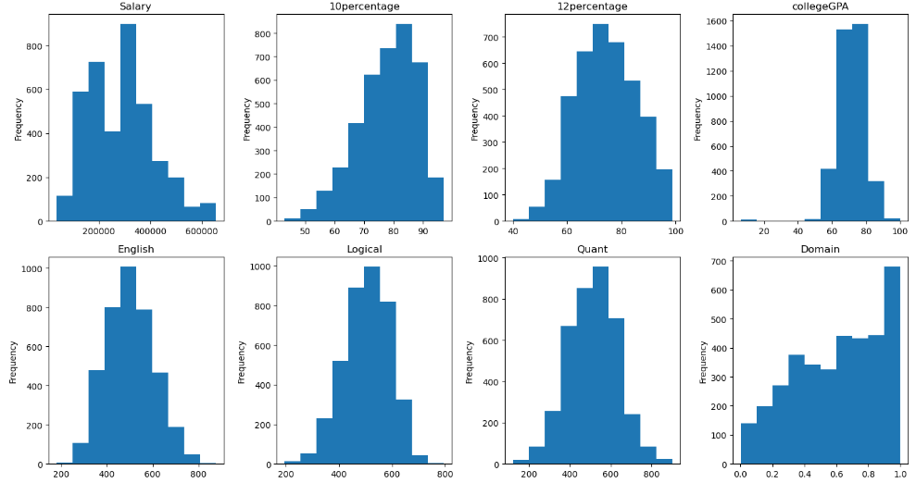
Univariate Analysis
I have plotted histograms for all numerical attributes and most of them show a normal distribution except for a few like MechanicalEngg, conscientiousness, agreeableness, extraversion and openness_to_experience

Slide 14
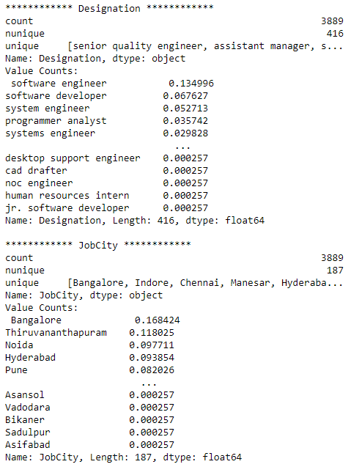
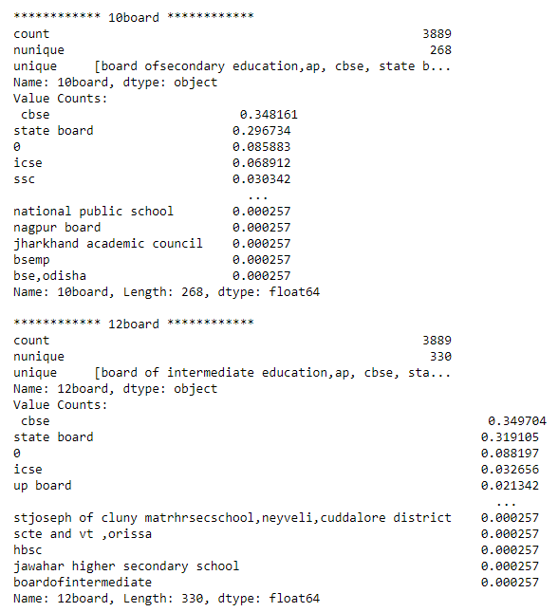
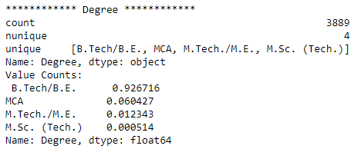
Univariate Analysis
I built a function that calculates the frequency, number of unique values, displays the unique values and the cardinality for each categorical column.
I moved on to look into Designation columns cardinality. It is observed that software engineers and developers occupy 20% of the data, followed by system engineers and programmer analysts that occupy around 10% of the data.
From Job City, we can observe that Bangalore hold the highest share of jobs followed by Thiruvananthapuram, Noida, Hyderabad and Pune.
Most of the students in 10 Board and 12 Board are from CBSE Board. About 92% of the students did B.Tech which is the highest among all. The least is M.Sc Tech which is around 0.03% only

Slide 15
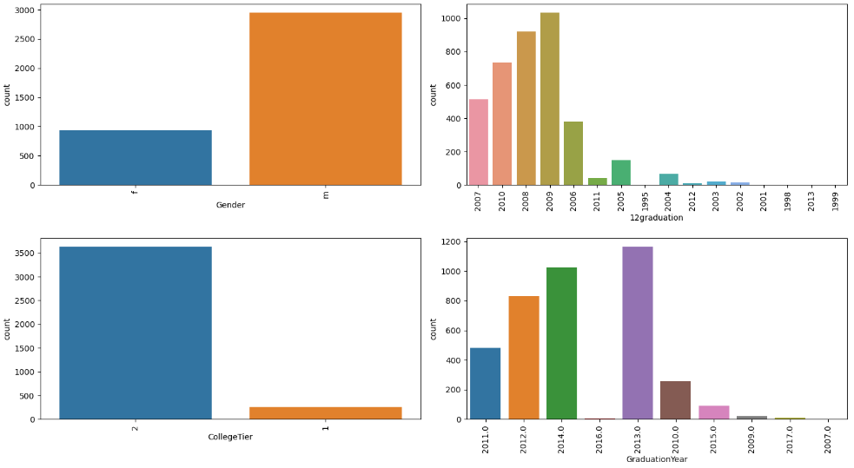
Univariate Analysis
I have plotted count plots for the categorical columns and observed that there are a lot more males than females. Males are about 75% and females are about 25% only.
There are more number of Tier 2 colleges than tier 1 significantly.
Most of the students have graduated their 12th Class in 2009 and there fore finished their college graduation in 2013

Slide 16
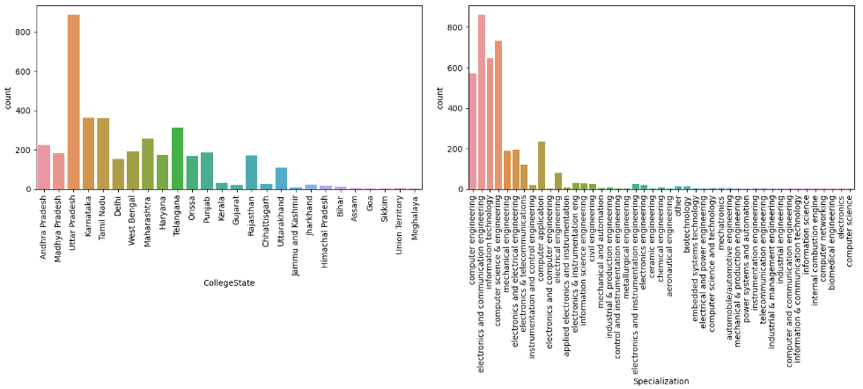
Univariate Analysis
Most of the colleges are from Uttar Pradesh and the least are from Goa, Sikkim, Meghalaya and Union Territories.
Most people pursued courses like ECE, CSE, Information Technology and Computer Engineering.

Slide 17
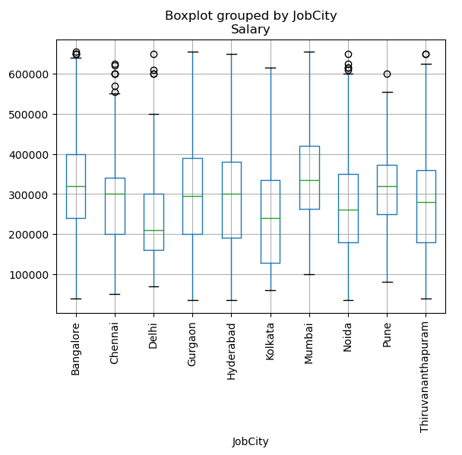
Bivariate Analysis
A box plot between Salary and JobCity is plotted filtered to top 10 JobCities.
It is clearly noticeable that Mumabai has the highest salaries surpassed by a small margin from pune and banglore.
Makes sense as Cost of living is high in mumbai and looking into the lowest salaries, they are in Delhi

Slide 18
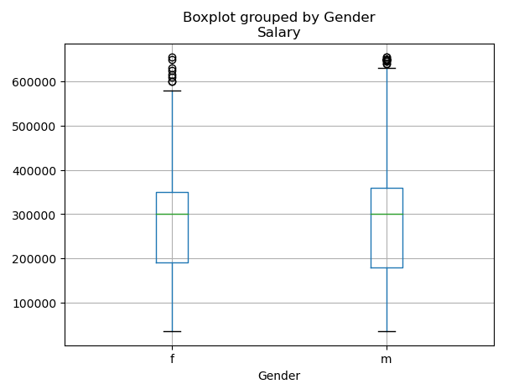
Bivariate Analysis
A box plot between Salary and Gender is plotted.
It is noticeable that there is no partiality shown in terms of salaries between Male and Females, which is an important point to note.

Slide 19
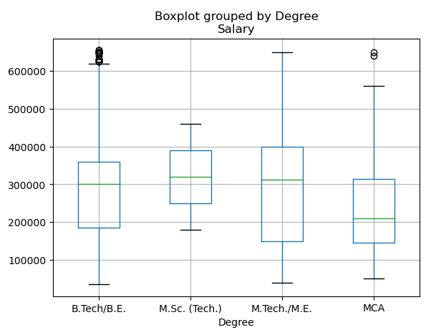
Bivariate Analysis
A box plot between Salary and Degree holding is plotted.
We can see that those with a M.Sc or M.Tech Degree earn the most over a slight margin from those with a B.Tech Degree.
The lowest earners are holders of MCA degree by a significant margin of close to 1 LPA.

Slide 20
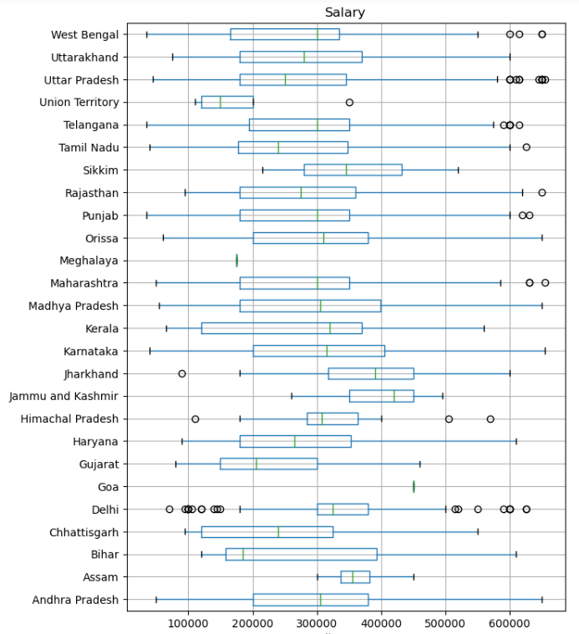
Bivariate Analysis
A box plot between Salary and CollegeState is plotted.
Surprisingly, jobs in J&K have the highest salaries. Jobs in Union Territories have the lowest salaries

Slide 21
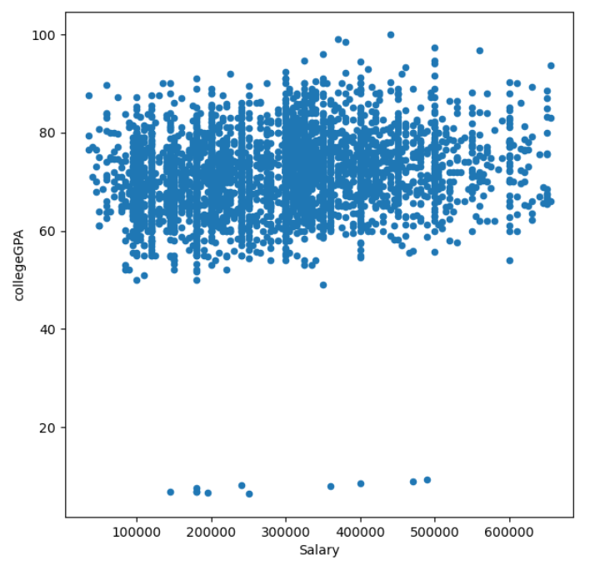
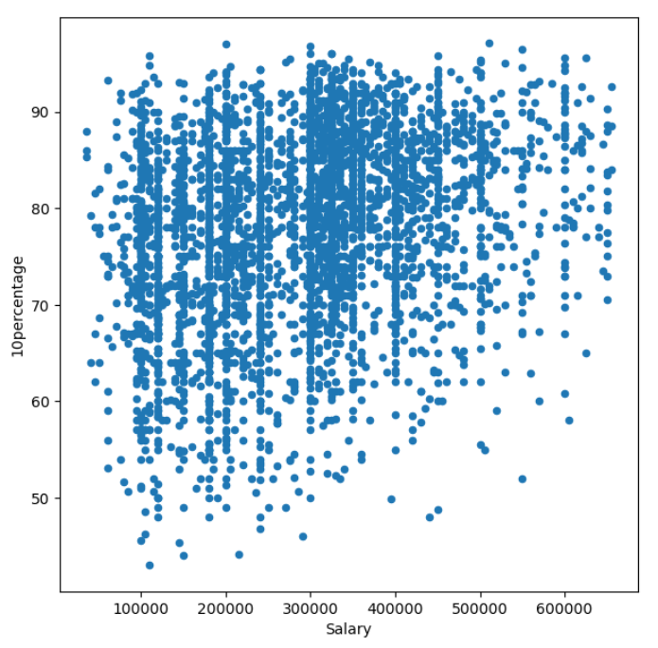
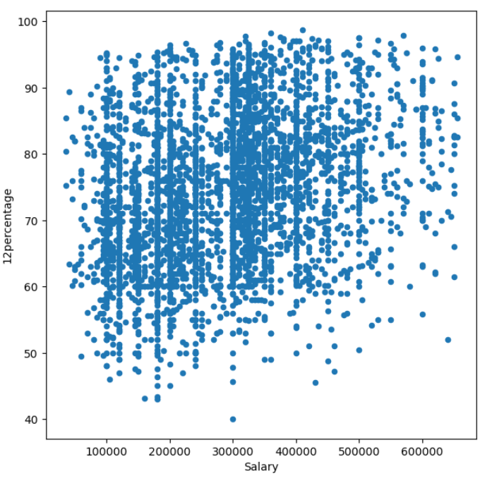
Bivariate Analysis
A box plot between Salary and collegeGPA is plotted.
The 10 Percentage, 12 Percentage, GPA in college does not play any role in determining the salary of an individual. From the graph, there are people who have a good score that earn around 1LPA as well as close to 6LPA

Slide 22
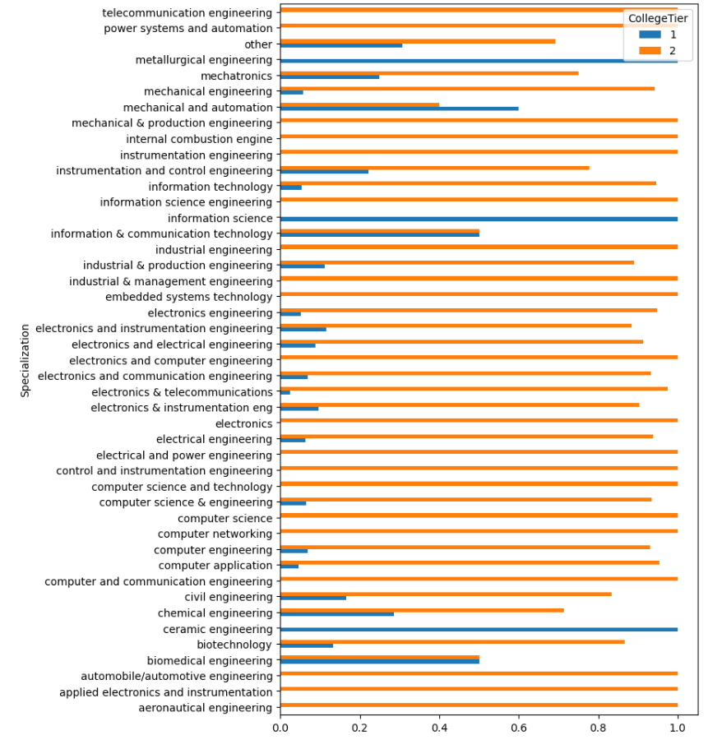
Bivariate Analysis
A box plot between Specialization and CollegeTier is plotted.
We can observe that most of the students are from Tier 2 colleges. Some courses like metallurgical engineering, information science, and ceramic engineering are offered by only tier 1 colleges.
Specializations like mechanical and production engineering, internal comustin endinge, instrumentation enginerring, and information science engineering, industrial management engineering, embedded systems technology, aeronautics and electronics are offered only by tier 2 colleges

Slide 23
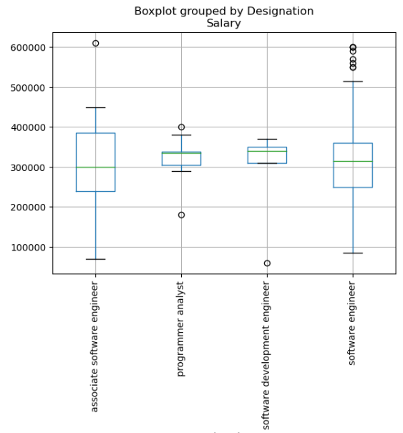
Research Question - 1
The hypothesis by the TOI articles is correct.
Those with jobs as a programming analyst, software engineers and hardware engineer and associate engineer can earn upto 2.5 - 3 lakhs per annum.
From the boxplot, we can see that all four are earing atleast 3LPA per annum.

Slide 24
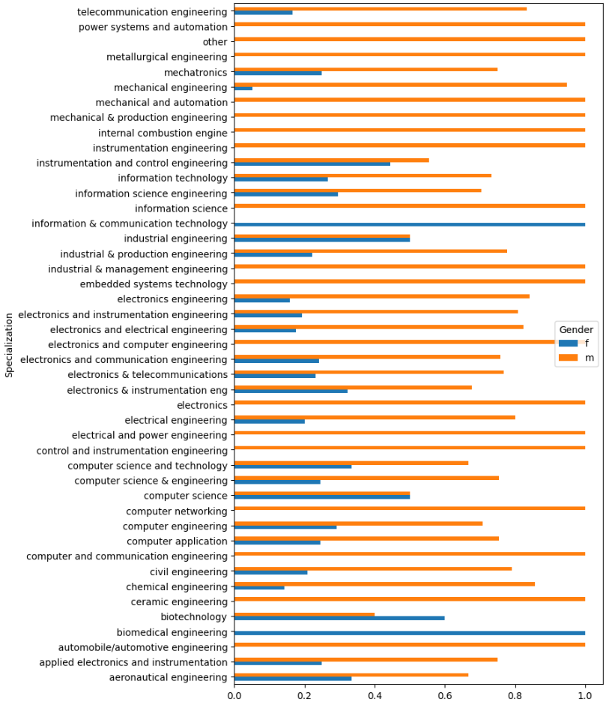
Research Question - 2
A box plot between Specialization and Gender is plotted.
We can observe that most of the students are Males. Biomedical engineering and information and communication technology courses are chosen by only females. Industrial engineering & computer science course has equal number of males and females.
Mechanical engineering has the lowest ratio of males and females. Courses that relate to mechanical, automotive, aeronautical, industrial and management have less females

Slide 25
Conclusion
To conclude there are many factors that affect the salary of a candidate.
The City at where the job is located (State and City), the designation, the degree of a candidate effect the salary.
Most people pursued courses such as CSE and ECE and most of the colleges are from Uttar Pradesh State.
Most of the jobs are in Banglore City and most of the candidates have studied in CBSE Board only.
Most of the candidates did B.tech about 92% of them only 0.03% of them have a degree in M.Sc (Tech)
The highest salaries are found in Mumbai city, but when seen in terms of state the highest is in Jammu & Kashmir
Both the Hypothesis in Research Questions 1 and 2 turned out to be True.

Slide 26

THANK YOU

